Slide 1
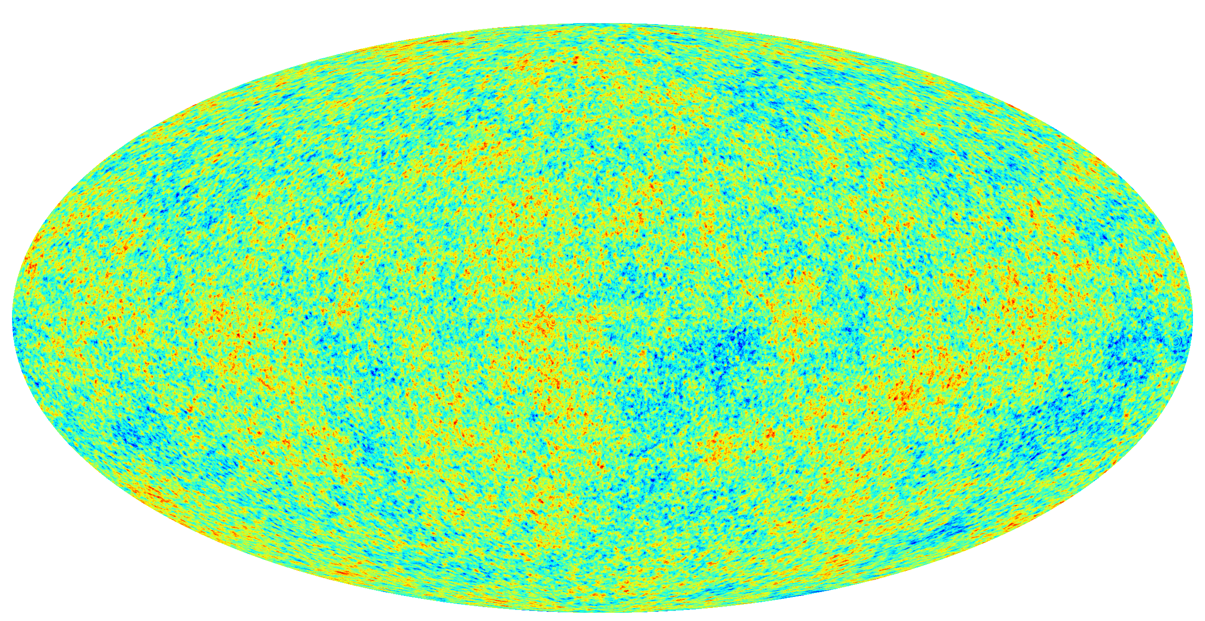
Physics Seminar Measurement of the Cosmic Microwave Background anisotropies and polarization with Planck Assoc. Prof. Guillaume Patanchon Astroparticle and Cosmology (APC) Laboratory, Paris Diderot University. Date and Time: Sep. 8th, 16:00-17:00 Place: Rigaku-bu Room 11
The Cosmic Microwave Background (CMB), emitted 380,000 years after the Big-Bang is the most important probe of modern cosmology. The small temperature anisotropies are the signature of metric fluctuations generated during the inflation phase of the Universe, which happened during the first fraction of second after the Big-Bang. They contain information about the cosmological parameters, quantifying the energy components as well as the physical conditions in the early Universe. The Planck satellite of ESA which was launched in may 2009 operated at L2 from august 2009 to august 2013 and allowed to map the CMB anisotropies and polarization on the full sky with unprecedented accuracy. Some of the parameters of the cosmological model were measured at the percent accuracy, the primordial scalar power spectrum shows significant deviations from scale invariant spectrum, and one of the important results is the strong constraints on the reionization parameter by measuring the polarization scalar modes. In this presentation, I will review the main cosmological results after introducing the Planck instrument. I will discuss the challenging analysis of Planck data, the main difficulties we had to face, and how we removed the main systematic effects. Finally, I will address the future challenges in measuring the CMB tensor mode polarization.
Contact: Hirokazu Ishino (7818), Dept. of Physics

